Slide 1
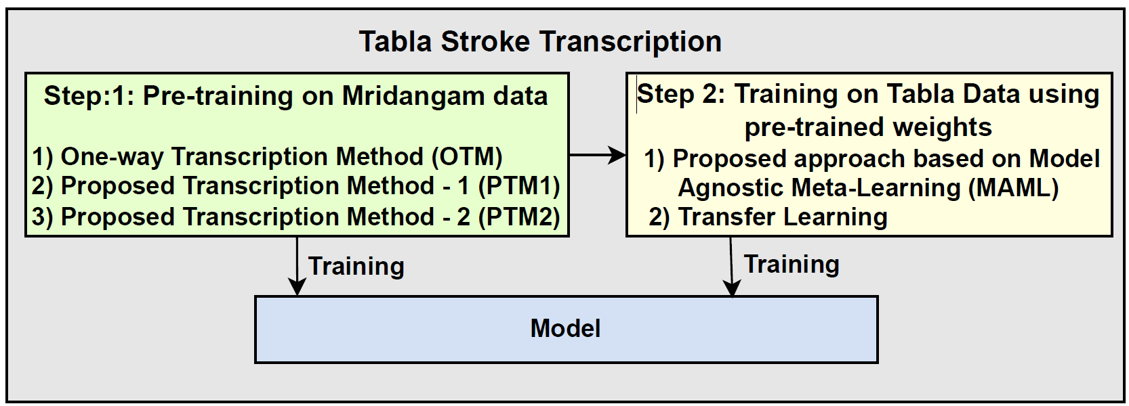

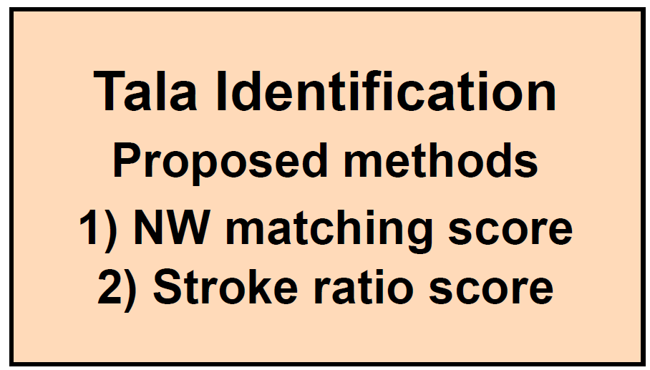

Tabla stroke transcription and t$\overline{a}la$ Identification
Input Test Audio
Transcription
Stroke, Onset (Sec)
Dha, 0.00
Dhin, 0.51
Dhin, 1.03
.
.
.
Tin, 58.96
Ta, 59.52
Predicted Tala
Tintala

Slide 2
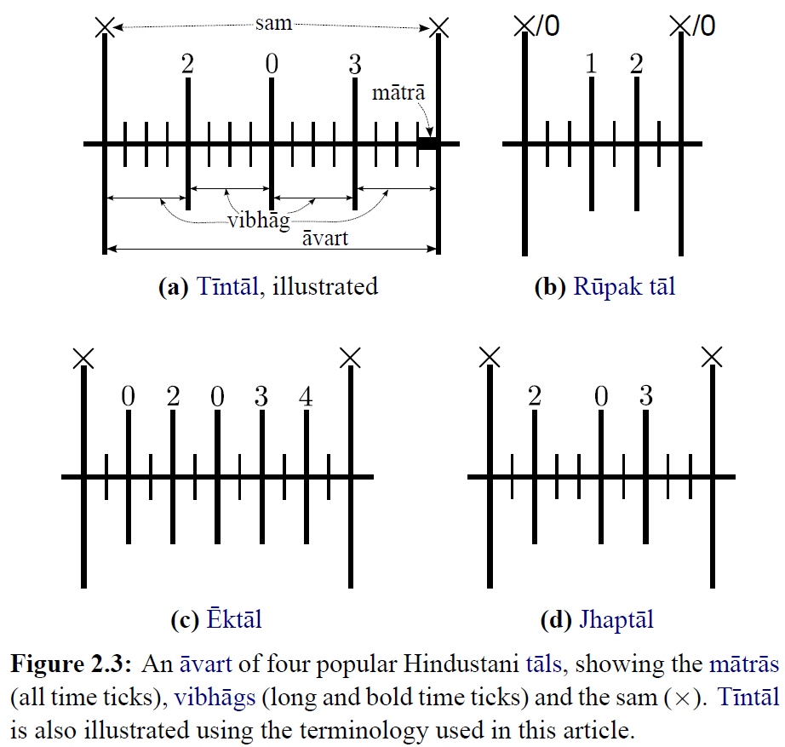
Tala in Hindustani Music
Outlines the rhythmic framework
Consisting of a fixed time cycle divided into primary units
called matra, grouped into sections called vibhags
Avart is the cycle, and sam is the start or downbeat
Each tala features predefined rhythmic patterns
known as the theka
There are various talas in Hindustani music
Most popular talas: Tintala, Ekatala, Jhaptala,
and Rupak tala
* Image Source: Srinivasamurthy, A. (2016). A data-driven Bayesian approach to automatic rhythm analysis of Indian art music.

Slide 3
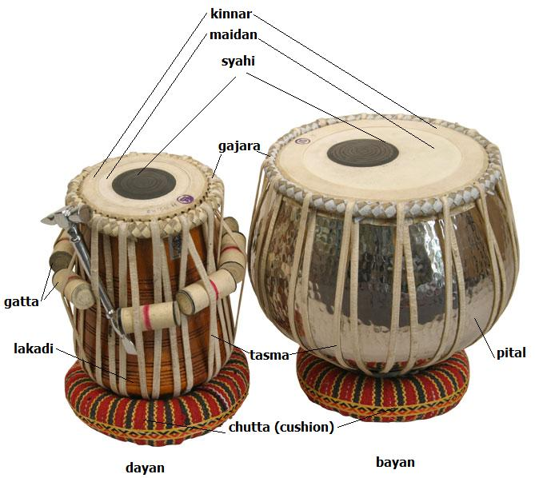
Tabla : Percussion instrument
Plays a central role in Hindustani music
Serves as the rhythmic backbone and accompanying instrument
for singers and instrumentalists
Helps singers maintain the structure, essence, and timing of the chosen raga (melodic framework)
Two drums: left-hand bass drum (bayan / dagga) and right-hand drum (dayan / tabla)
Drums produce various pitched sounds, played with palms and fingers
These pitched sounds are articulated through specific syllables known as bols.

Slide 4
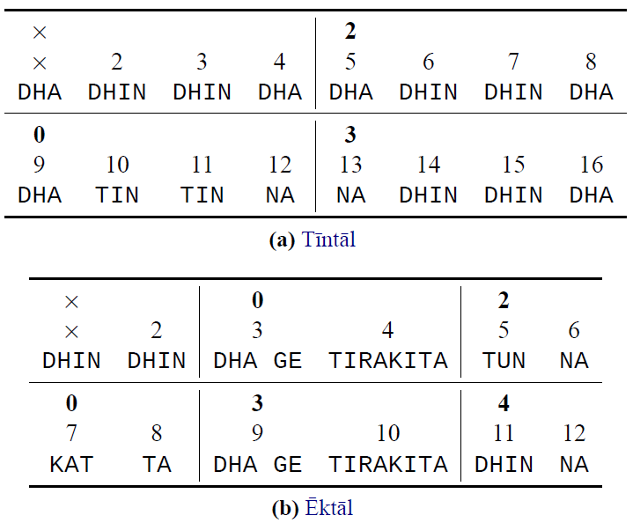
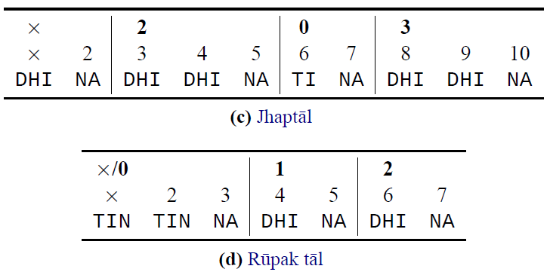
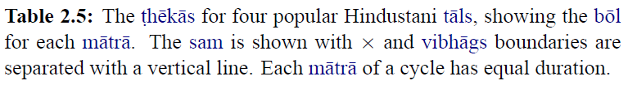
Theka
Specific canonical tabla bol patterns i.e., predefined rhythmic patterns defined for each tala
* Srinivasamurthy, A. (2016). A data-driven Bayesian approach to automatic rhythm analysis of Indian art music.

Slide 5
Tala identification
Talas are primarily identified by their theka, which maintains a fixed bol (stroke) sequence
Tabla stroke transcription is crucial for tala identification to capture stroke sequence transcription similar to Automatic Drum Transcription (ADT) in Western music
Few studies have focused on tabla stroke transcription, with recent efforts emphasizing deep-learning models
A major challenge with deep learning approaches is the need for large, labelled datasets
To address the challenge of limited labeled datasets, this paper introduces a new stroke transcription method based on Model-Agnostic Meta-Learning (MAML), which effectively operates with minimal data.
While some studies have explored music sequence matching, these approaches are not directly applicable to tala identification from stroke sequences
We proposed two new tala identification methods:
NW Matching Score based on the Needleman-Wunsch algorithm.
Stroke Ratio Score based on Cosine Similarity.

